Slide 1
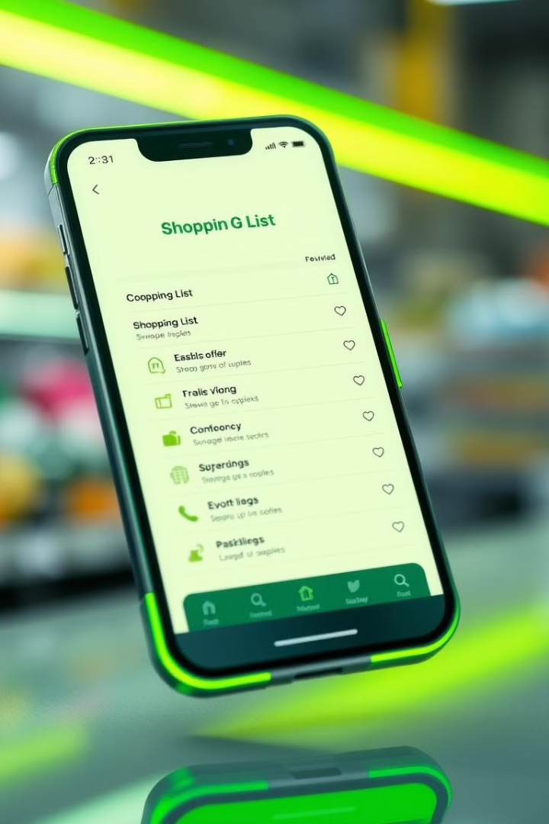
Shopping List App: Built with Modern Web Technologies
A cross-platform mobile solution for efficient grocery management. Developed using HTML, CSS, JavaScript, and React. Compiled with Capacitor for native Android functionality. Streamlining the shopping experience with intuitive features.

Slide 2

Core Functionality: Simplifying Your Shopping
1
Add Items
2
Modify Items
Quickly input items with name, quantity, and details. For example: "Milk, 1 gallon, Organic, $10".
Easily update existing items. Change "Milk, 1 gallon, $10" to "Milk, 2 gallons, $20".
3
Delete Items
4
Check Complete
Remove unwanted items from the list with a simple swipe or tap.
Mark items as purchased to track progress. Visual confirmation: strikethrough or color change.

Slide 3





Interactive Demo: Add, Modify, Delete, Check Complete
Add
Add a product.
Modify
Change its properties.
Delete
Remove the product.
Check
Mark complete.
Live demonstration of key functionalities using the app interface. Clear steps showcase ease of use. Add "Eggs," modify to "Eggs, Dozen," delete, and mark as complete.

Slide 4
Technology Stack: HTML, CSS, JavaScript, React
HTML (Structure)
CSS (Styling)
JavaScript (Logic)
React (Framework)
Creates the foundation and layout of the user interface.
Enhances the visual appeal with custom styles, fonts, and responsive design. Utilizes CSS frameworks.
Component-based architecture for efficient UI development.
Implements interactive features and manages app behavior.

Slide 5



Capacitor: Bridging Web to Native Android
Native Features
2
Access device functionalities.
Native Performance
1
Achieve fast, efficient processing.
Android Deployment
3
Publish directly to the Google Play Store.
Capacitor is an open-source bridge that enables web applications to run natively on Android devices. This allows access to native device features and functionalities, providing a seamless user experience. See the .apk file of the app running on an android device.

Slide 6




Dashboard & SQLite: Data Storage and Visualization
SQLite
Dashboard
Advantages
Lightweight, embedded database for local storage.
Overview of shopping habits and spending trends.
Offline, fast retrieval, and secure storage.

Slide 7
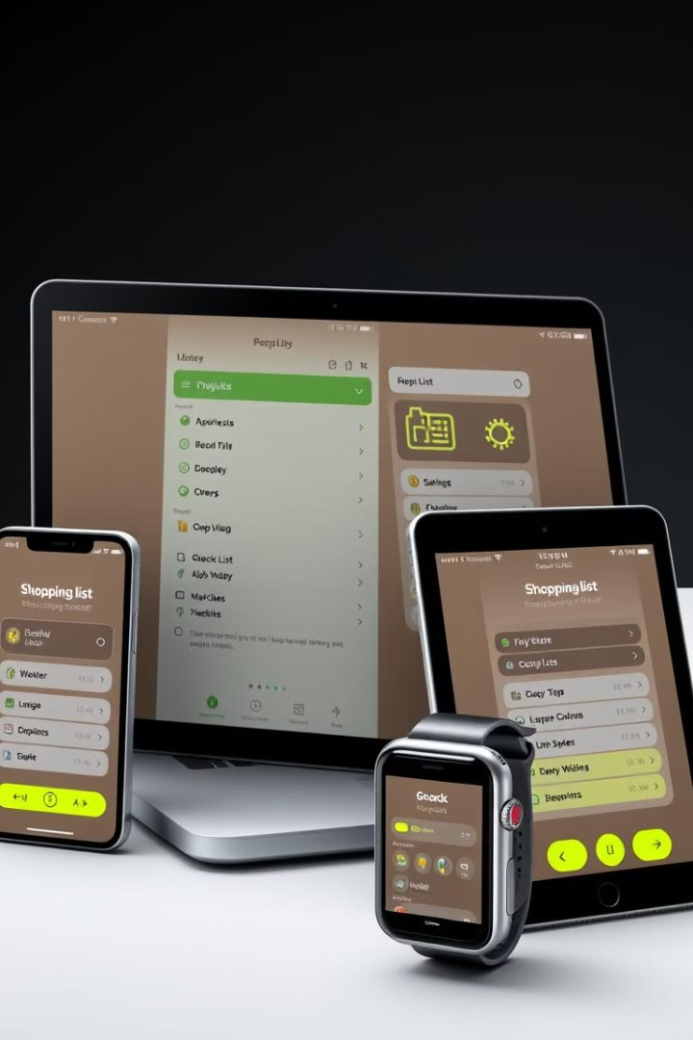
Benefits and Advantages
Cross-Platform
Single codebase for both iOS and Android.
Offline
Access and modify lists without internet.
User-Friendly
Intuitive design for seamless navigation.
Cost-Effective
Leverage web development skills.

Slide 8



Key Features for Enhanced Shopping
Optical Recognition
History
Budgeting
Capture items directly. Add them by taking a photo.
Preserve Log from previous Lists
Tools for controlling your spending.

Slide 9
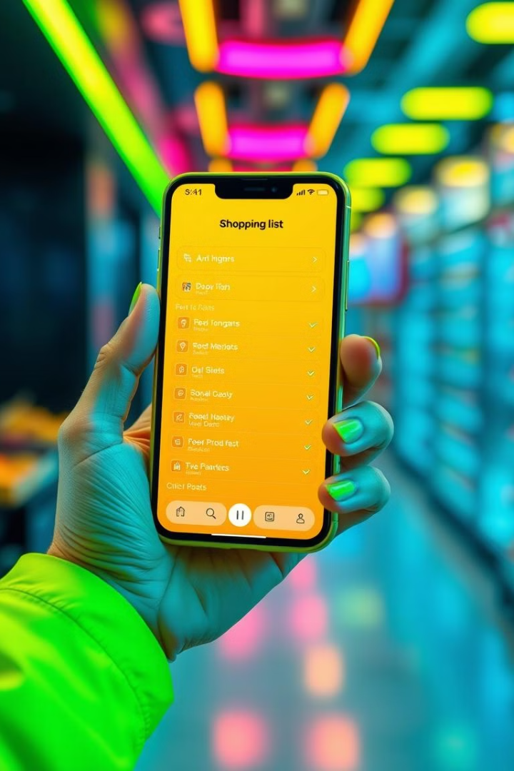
Conclusion: Simplify Your Shopping Today!
This Shopping List App combines web technologies to deliver a native-like mobile experience. Download now from [link to app store or website]. Start simplifying your grocery shopping and stay tuned for upcoming feature enhancements!

